Slide 1
CSE 212: Object Oriented Programming Sessional
Presented To -
MD. MUHTADIR RAHMAN
Lecturer,
Department of Computer Science & Engineering
Port City International University
Project Title : Hospital Management System
Presented By -
Md Akash Rahman (CSE 02107004)
Md Safi Ullah (CSE 02107001)
Rimon Kanthi Dev Nath (CSE 02107002)
Department of Computer Science and Engineering Port City International University

Slide 2
CONTENTS
Problem Statements
Motivation
Problem Objectives
Preliminary Solution
Use Case Diagram
Activity Diagram
Project scopes
i) Functions/Functional Requirements
ii) Features/Non Functional Requirements
Project Stackholder
ER – Diagram
UI – Design
Cost Analysis
Conclusion
Question & Answer

Slide 3
Problem Statement
HOSPITAL MANAGEMENT SYSTEM PROBLEM STATEMENT It is very important to maintain efficient software to handle information of a Hospital.
This application provides a way to record this information and to access these in a simple way.

Slide 4
Problem Objective
Design a system for better patient care.
Reduce hospital operating costs.
Provide MIS (Management Information System) report on demand to management for better decision making.
Better co-ordination among the different departments.
Provide top management a single point of control.

Slide 5
Preliminary Solution
This work is focused on the development of a computer aided Hospital Management System and specifically on hospital information systems (IS).
This allows us to easily store patient and doctor details.
Health care in Bangladesh, as in many other countries, is with a growing demand for medical treatments and services. For that our project will help completely digitalization of a hospital.

Slide 6
USE CASE DIAGRAM :
LOGIN
WECOME
Add Doctor
Doctors
Edit Doctor Details
Authority
Fire Doctor
View Doctor Details
Admit New Patient
Patients
Edit Patient Details
Discharge Patient
View Patient Details

Slide 7
ACTIVITY DIAGRAM :
Start
Log In
End
List
Doctor
Back
Patient
Add | Update | Delete | View
Add | Update | Delete | View
Logout
Back
Back
Logout
Back

Slide 8
Project Scopes
Functions/Functional Requirements :
1. Login system for all.
2. Taking information of patient.
3.Choice Doctor.
4. View information of Doctor.
5. Location of hospital view in map
Features/Non Functional Requirements :
1. Location will be shown in google
2. System will run on Android device
3. Movement of users will be shown mар in real-time

Slide 9
Project Stakeholders
Authority
Doctors
Patients

Slide 10
Project Stakeholder : (Continued)
Authority :-
Doctor Information
Information of basic operation
Patient Appointment
View Doctor Information
Emergency Service
Ambulance Service

Slide 11
Project Stakeholder : (Continued)
Doctors :-
Login System
Set Appointment for patient
View Patient Information
Upload Prescription
Patients :-
Login System
View Doctors Information
Choosing Doctor
Describe About Diseases

Slide 12
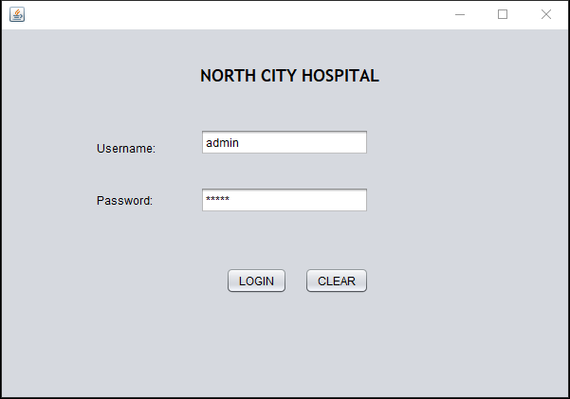
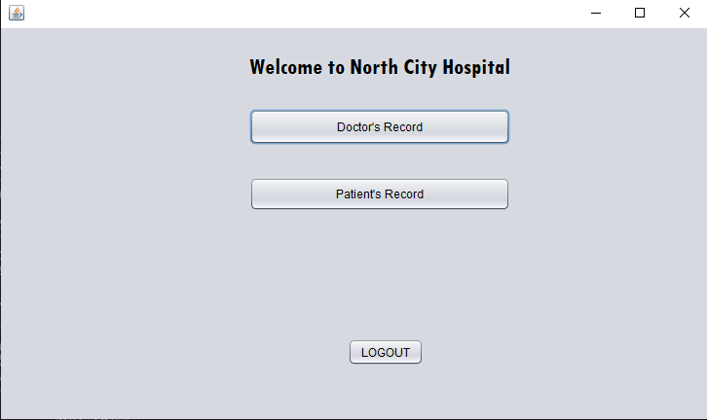
USER INTERFACE (UI) :
Log In Page
Welcome Page

Slide 13
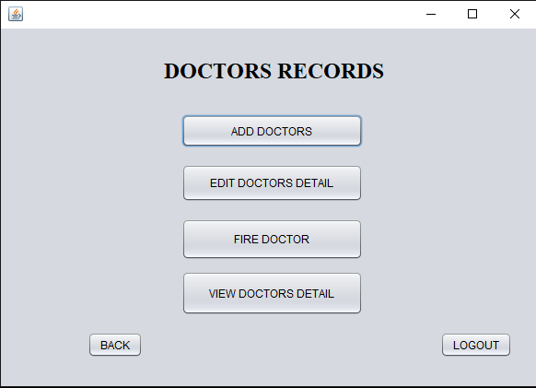
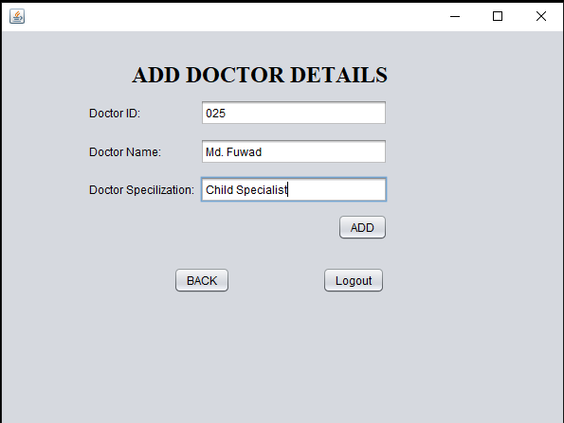
USER INTERFACE (UI) : (Continued)
Doctors home Page
Doctor Adding Page

Slide 14
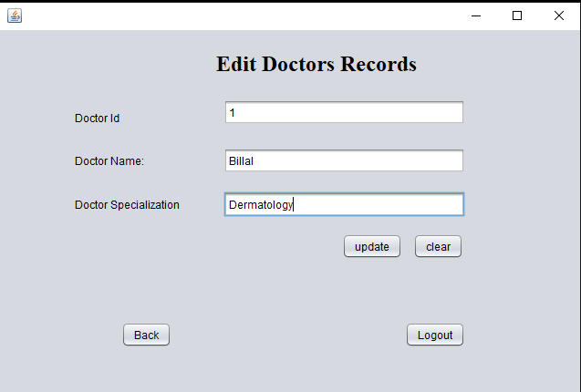
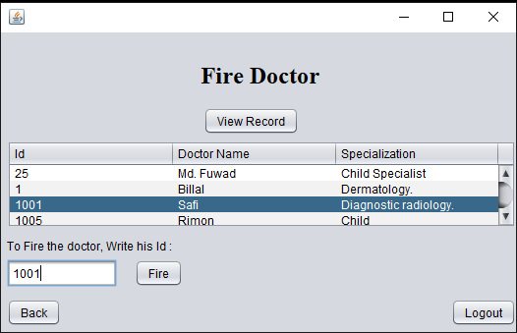
USER INTERFACE (UI) : (Continued)
Doctors Updating Page
Doctor Deleting Page

Slide 15
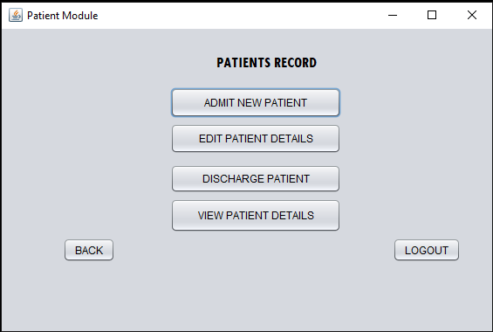
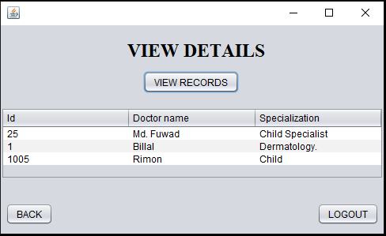
USER INTERFACE (UI) : (Continued)
Doctors View Page
Patients home Page

Slide 16
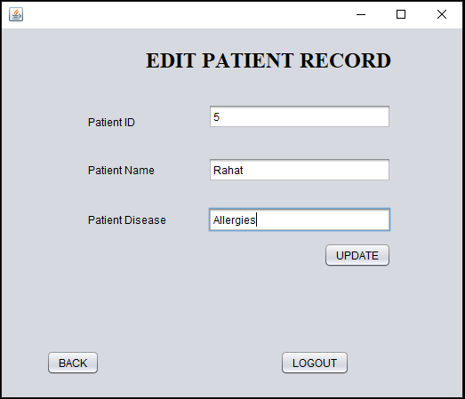
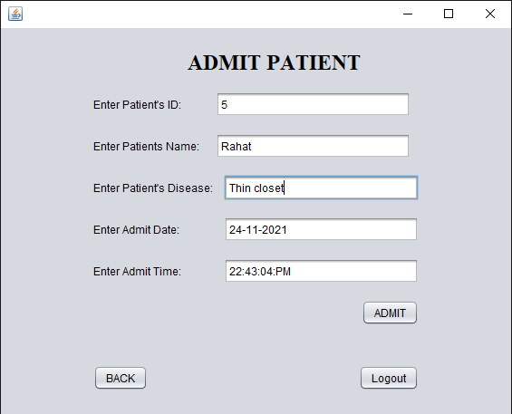
USER INTERFACE (UI) : (Continued)
Patient admit Page
Patient updating Page

Slide 17
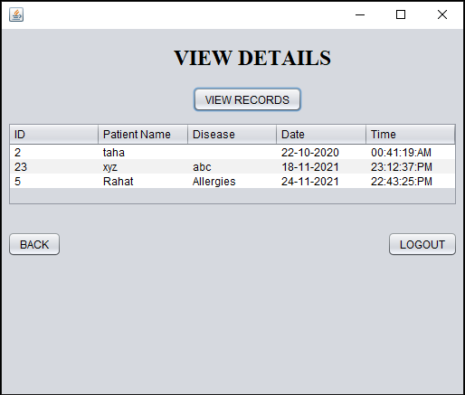
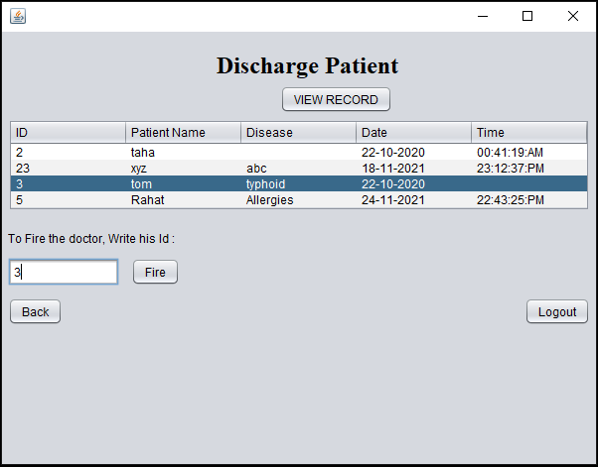
USER INTERFACE (UI) : (Continued)
Patient discharge Page
Patient view Page

Slide 18
COST ANALYSIS:
Finding Alternatives -
Table 1.1: Description of Alternatives
Alternative 1 | Alternative 2
Building Project using software developement | Building Project using software developement
Personal PC | Workstation PC
Web Server | Web Server
Database Server | Database Server
Data Entry | Data Entry

Slide 19
COST ANALYSIS:
Alternative 1 -
Table 1.3 : Summary of cost for alternative 1
Serial No | Item | Amount (Tk)
1 | Building Project using software developement | 50,000
2 | Personal PC | 40,000
3 | Web Server | 35,000
4 | Database Server | 25,000
5 | Data Entry | 20,000
 | Total | 1,70,000

Slide 20
COST ANALYSIS: (Continued)
Alternative 2 -
Table 1.3 : Summary of cost for alternative 2
Serial No | Item | Amount (Tk)
1 | Building Project using software developement | 50,000
2 | Workstation PC | 80,000
3 | Web Server | 50,000
4 | Database Server | 40,000
5 | Data Entry | 35,000
 | Total | 2,55,000

Slide 21
COST ANALYSIS: (Continued)
COMPARISON BETWEEN ALTERNATIVES :
After analyzing the alternatives in different sectors like economical, operational and technical according to money and time constraints, we recommend the best one of them on the basis of different features.
Table 1.4 : Comparison between alternatives
Serial No | Feature | Alternative 1 | Alternative 2
1 | Investment | 1,70,000 Tk | 2,55,000 Tk
2 | System Life Cycle | 5 Years | 5 Years
3 | Return Value | 8,65,000 Tk | 3,25,000 Tk
4 | Payback Period | < 3 Years | 10+ Years
Alternative 1 is more preferable than alternatives 2 as it returns the investment in least amount of time. So, Alternative 1 can be taken up to continue the project.

Slide 22
Conclusion
Hospital management system is all about the modernizing a hospital through use of technology. Computers helps in it and take over the manual system for quick and easy functioning.
This hospital management system is a quite the reliable and is proven on many stages. All the basic requirements of the hospital are provided in the hospital in order to manage it perfectly and large amount of data can also be stored .
It gives many facilities like searching for the detail of patient , billing facilities as well as the creation of test reports. So its a important system for modern days.

Slide 23
Thank You

Slide 24
Any question?

